Slide 1

UML Case-Study
Batch – 2
121810311013 – Sreeraj Kasa
121810311023 – B. Tanmay
121810311031 – Sindhu Bommali
121810311044 –Meghana Madarapu
121810311056- Justin Clarke

Slide 2

Hotel Management

Slide 3
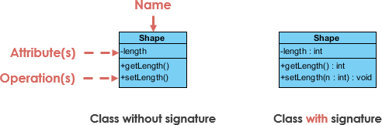
Class Notation
UML class is represented by the following figure. The diagram is divided into four parts.
The top section is used to name the class.
The second one is used to show the attributes of the class.
The third section is used to describe the operations performed by the class.
The fourth section is optional to show any additional components.

Slide 4
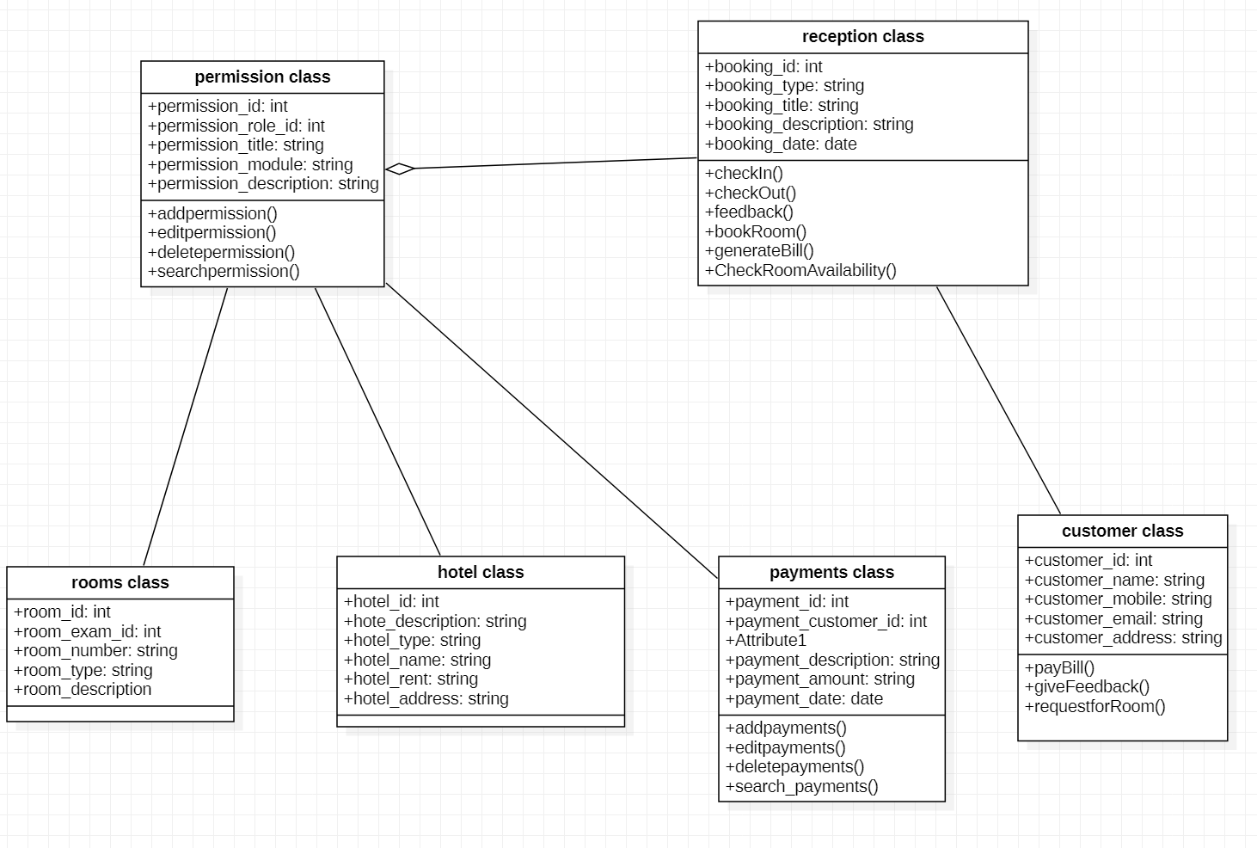
Class Diagram

Slide 5
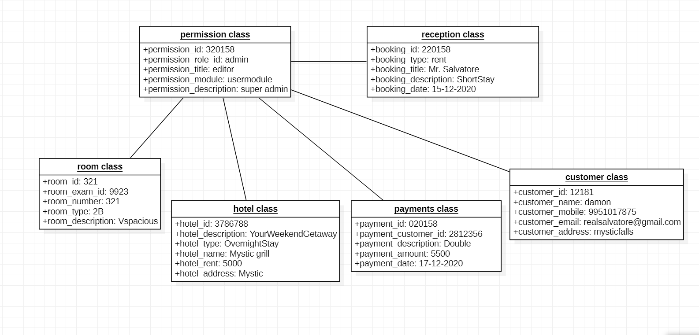
Object Diagram

Slide 6
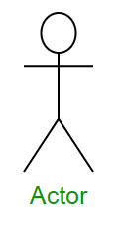
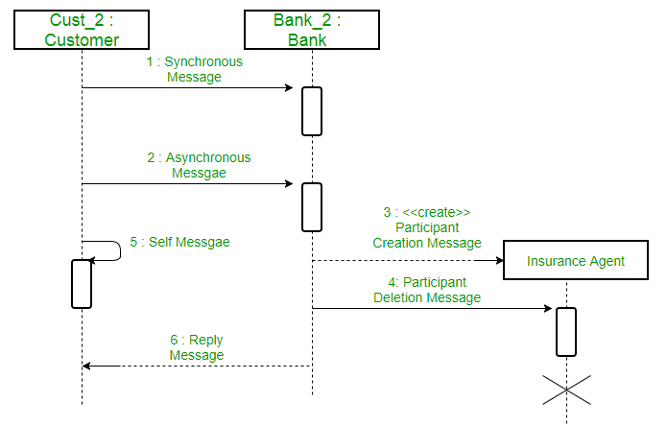
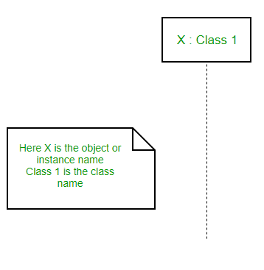
Sequence Notation
An actor in a UML diagram represents a type of role where it interacts with the system and its objects.
A lifeline is a named element which depicts an individual participant in a sequence diagram.
Communication between objects is depicted using messages.

Slide 7
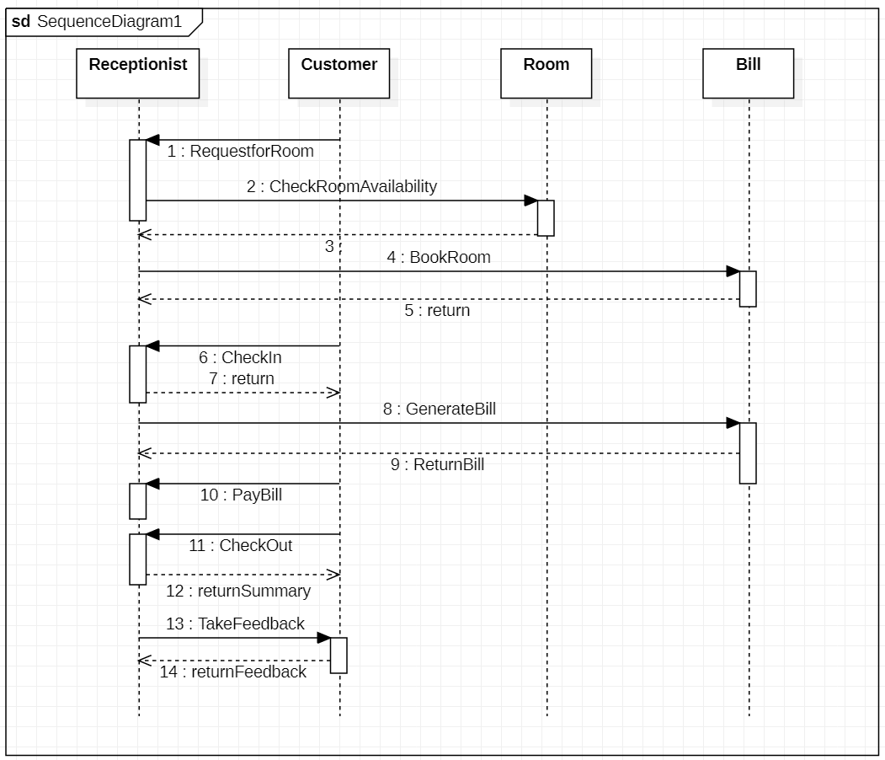
Sequence Diagram

Slide 8
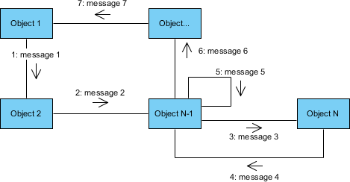
Communication Notation
A communication diagram is an extension of object diagram that shows the objects along with the messages that travel from one to another.
Messages passed between objects are represented by labeled arrows.
Messages that objects send to themselves are indicated as loops.

Slide 9
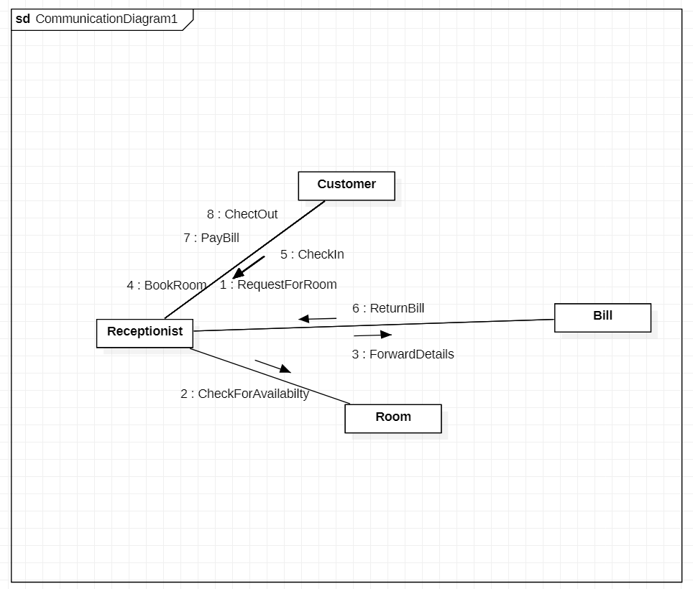
Communication Diagram

Slide 10
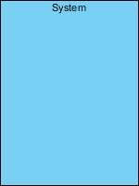



Use-case Notation
A use case represents a user goal that can be achieved by accessing the system or software application.
Actor and use case can be associated to indicate that the actor participates in that use case.
The scope of a system can be represented by a system (shape), or sometimes known as a system boundary.
An include relationship specifies how the behavior for the inclusion use case is inserted into the behavior defined for the base use case.
An extend relationship specifies how the behavior of the extension use case can be inserted into the behavior defined for the base use case.
A generalization relationship is used to represent inheritance relationship between model elements of same type.

Slide 11
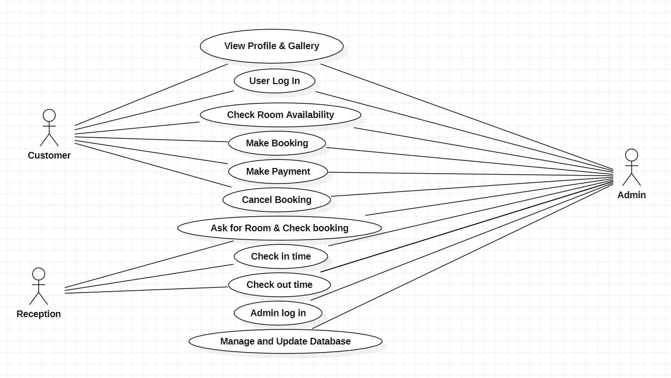
Use-case Diagram

Slide 12
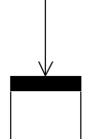



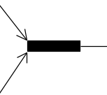

State-chart Notation
State: This notation is used to represent a state at which the process is.
Transition: This arrow is called transition that is used to show flow of states.
Decision node: This is used when we need to decide next state based on the answer of yes/no.
Fork: This notation used when a single flow splits into 2 different flows.
Join: This is used when two different flows merge.
Initial node: This shows begin of the task/process.
Final node: This shows the completion/termination of process/task.

Slide 13
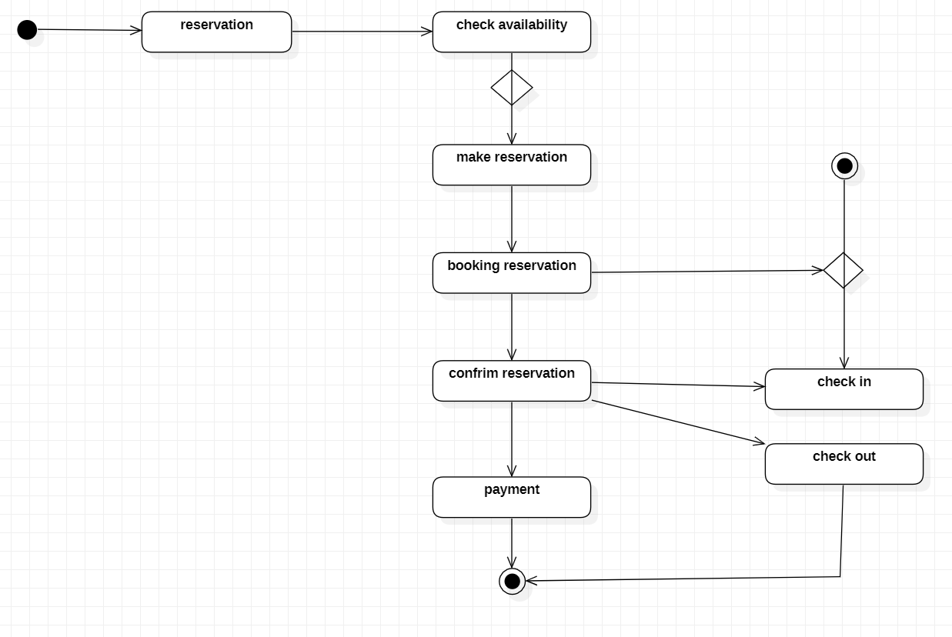
State-Chart Diagram

Slide 14
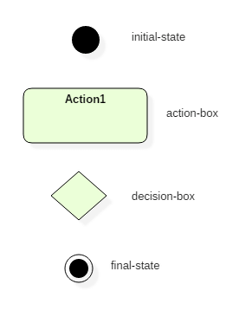
Activity Notation
Initial states: The starting stage before an activity takes place is depicted as the initial state.
Final states: The state which the system reaches when a specific process ends is known as a Final State.
State or an activity box.
Decision box: It is a diamond shape box which represents a decision with alternate paths. It represents the flow of control.

Slide 15

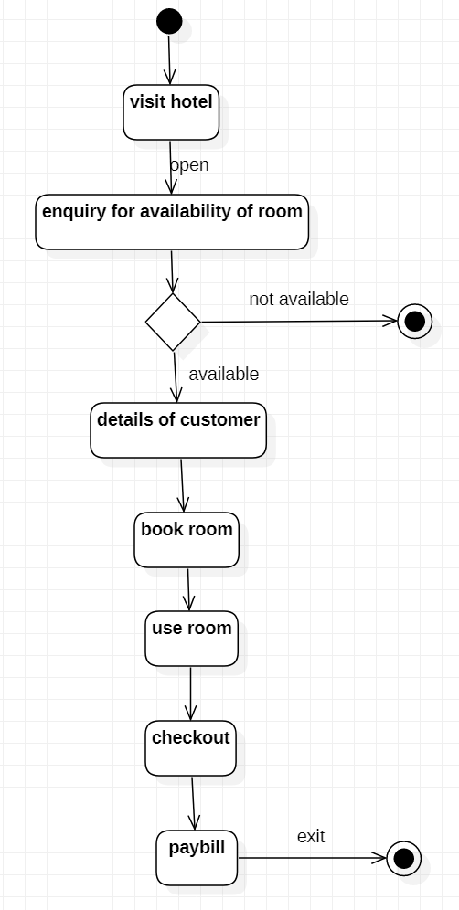
Activity Diagram (Entry into the Hotel)

Slide 16
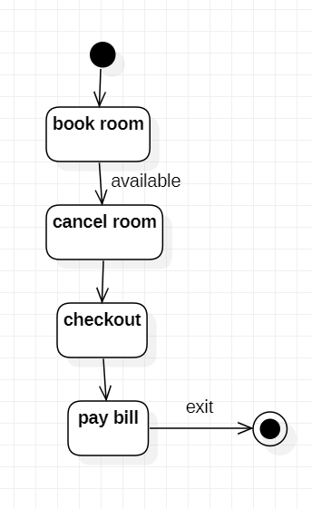
Activity Diagram (Exit from the Hotel)

Slide 17
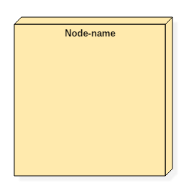
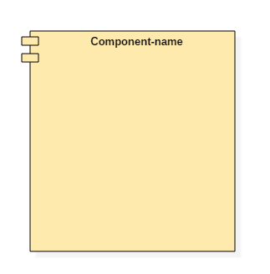
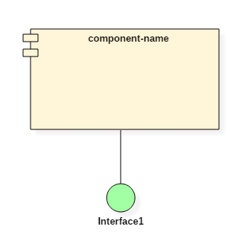
Component Notation
Component: A component in the Unified Modeling Language represents a modular part of a system that encapsulates the state and behavior of several classifiers.
Node: A node in the Unified Modeling Language is a computational resource upon which UML artifacts may be deployed for execution.
Port: A port is an interaction point between a classifier and an external environment. It groups semantically cohesive set of provided and required interfaces.

Slide 18
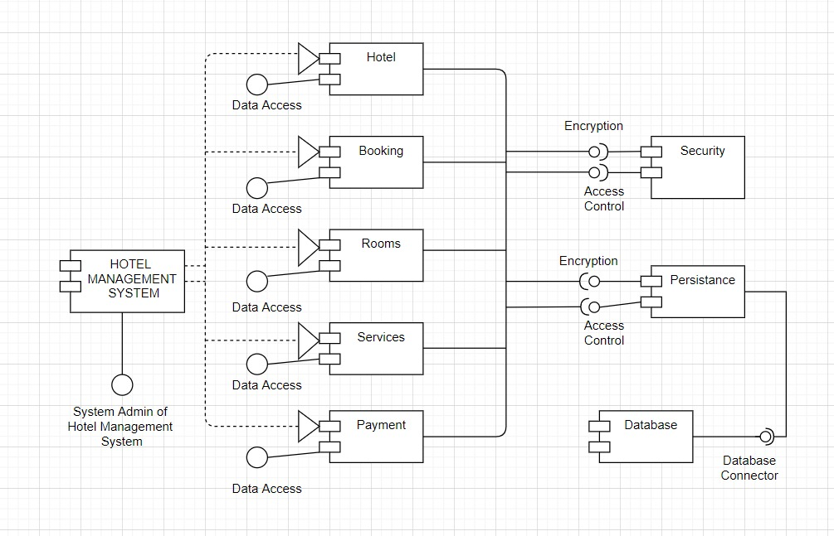
Component Diagram

Slide 19
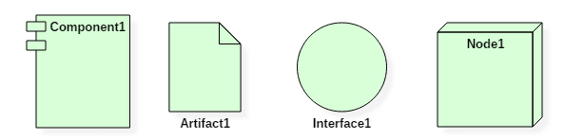
Deployment Notation
Deployment Diagram is a type of diagram that specifies the physical hardware on which the software system will execute.
A deployment diagram consists of the following notations:
A node
A component
An artifact
An interface

Slide 20
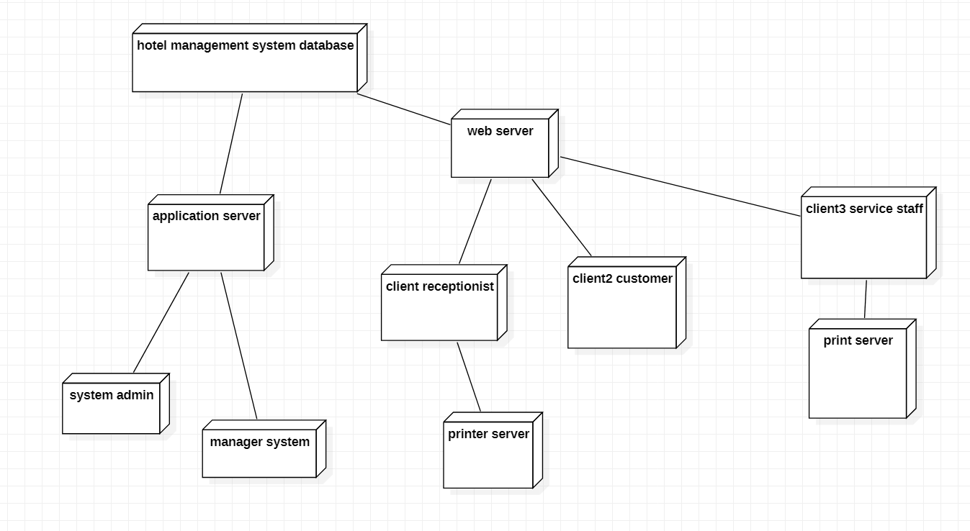
Deployment Diagram

